Slide 1


Institute of Technology of Cambodia
Department of Information and
and Communication Engineering
Credit Card Fraud Detection
Student : LIV Bunthorn
Lecturers: Dr.PHAUK Sokkhey, CHAN Sophal
Course : Data mining
Academic Year 2021-2022

Slide 2
Table of Contents
Page
I
Introduction
1
II
Objective
2
III
Tool
3
IV
Methodology
4
V
Conclusion & Future Work
13

Slide 3
I
Introduction
Most of People using credit card, there were approximately 22.8 billion credit, debit, and prepaid cards in use worldwide,Statista(2019)
Global payment fraud has more than tripled in the last decade, from $9.84 billion in 2011 to $32.39 billion in 2021, Spend Journal
1

Slide 4

II
Objective
Using machine learning to detect fraud in credit card.
2

Slide 5


III
Tool
The Jupyter Notebook is an open source web application that you can use to create and share documents that contain live code, equations, visualizations, and text.
Overleaf is a collaborative cloud-based LaTeX editor used for writing, editing and publishing scientific documents
3

Slide 6

IV
Methodology
Data collection
Dataset use in this project get from kaggle,this data contain 492 frauds out of 284,807 transactions, transactions made by credit cards in September 2013 by European cardholders.
4

Slide 7
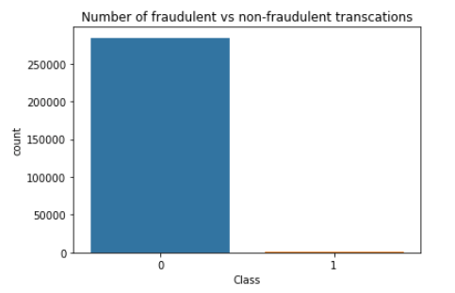
IV
Methodology
Data visualization
5

Slide 8
IV
Methodology
Outliers treatment
We are not performing any outliers treatment for this particular dataset. Because all the columns are already PCA transformed, which assumed that the outlier values are taken care while transforming the data.
6

Slide 9
IV
Methodology
Train-Test Split
80% of datasets use for training set and 20 % for testing set.
7

Slide 10
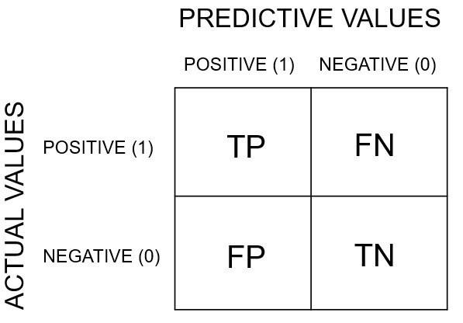
IV
Methodology
Evaluation metrics
Accuracy = (TP+TN)/(TP+FP+FN+TN)
Sensitivity = TP/(TP+FN)
Specificity =TN/(TN+FP)
F1-score =2*(Recall * Precision) / (Recall + Precision)
Recall = TP/(TP+FN), Precision = TP/(TP+FP)
8

Slide 11
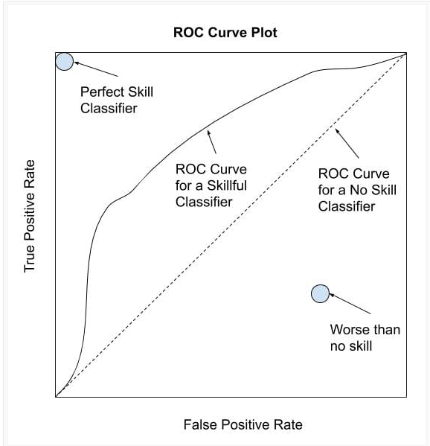


IV
Methodology
Evaluation metrics
An ROC curve (receiver operating characteristic curve) is a graph showing the performance of a classification model, This curve plots two parameters:
True Positive Rate :
False Positive Rate :
9

Slide 12
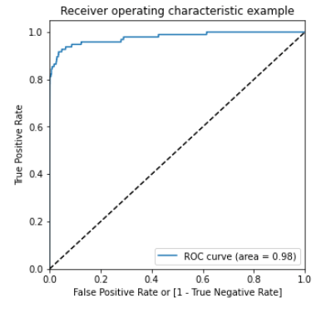

IV
Methodology
Logistic regression
Logistic regression is a statistical analysis method to predict a binary outcome, such as yes or no, based on prior observations of a data set.
10

Slide 13
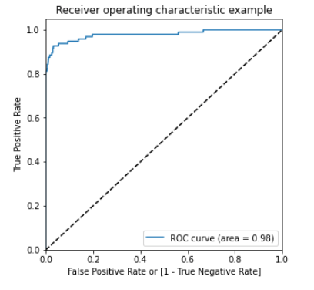

IV
Methodology
XGBoost
XGBoost, which stands for Extreme Gradient Boosting, is a scalable, distributed gradient-boosted decision tree (GBDT) machine learning library.
11

Slide 14
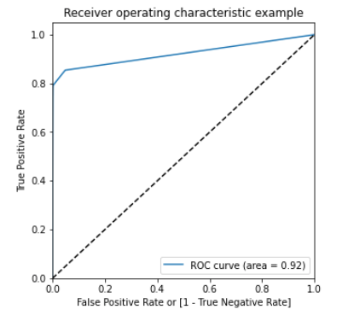

IV
Methodology
Decision Tree
Decision Tree is a Supervised learning technique that can be used for both classification and Regression problems, but mostly it is preferred for solving Classification problems.
12

Slide 15
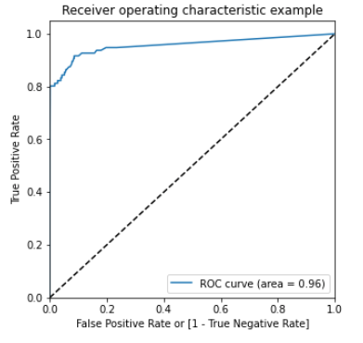

IV
Methodology
Random forest
Random forest is a Supervised Machine Learning Algorithm that is used Classification and Regression problems. It builds decision trees on different samples and takes their majority vote for classification and average in case of regression.
13

Slide 16
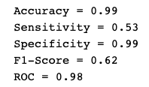
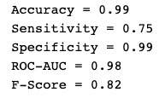
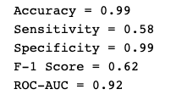
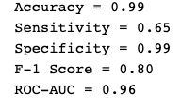
IV
Methodology
Algorithm Comparision
Logistic regression
XGBoost
Decision Tree
Random forest
After experiment 4 algorithms we can see XGBoost is the best algorithm
14

Slide 17
V
Conclusion & Future work
Conclusion
Understand about to read and summary paper
Know the important of data
Apply algorithm from class to project
Future Work
build model on balanced data
15

Slide 18
The End
Thank you
for listening

